Slide 1
LLM Agent Architectures
-Suhas Pai
CTO, Hudson Labs (formerly called Bedrock AI)

Slide 2

About Me
CTO & ML Research @ Hudson Labs
Writing the book ‘Designing LLM Applications’ published by O’Reilly Media.
Co-chair, Privacy working group at Big Science (BLOOM), 2021-2022
Chair, TMLS (Toronto Machine Learning Society) conference
Lately been communicating more with LLMs than humans

Slide 3
Agenda
01
02
03
04
What are Agents?
Task Decomposition
…and multi-agents???
through prompt incantations
Planning
Retrieval
Underrated & Overrated
The bane of GPT-4?

Slide 4
Agenda
05
06
07
08
Tool Selection
Tool Use
Answer Verification
The Scaffolding
NP Problems?
Turns out the orchestration software was the real AGI all along

Slide 5
01
What are Agents?

Slide 6
LLM Strengths
LLM Limitations
Instruction Following
Low-level NLP tasks
Code generation
Summarizing/Paraphrasing*
Reasoning
Factuality & Grounding
Weak at math except rudimentary arithmetic
Knowledge limited to training cutoff date

Slide 7
Enable LLM to interact with its environment
Memory & Data Stores
Models & Software (Tools)
Self-augment

Slide 8
Test Case 1
‘Who was the CFO of Apple during the time when Apple’s stock price was at its lowest in the last 10 years?’

Slide 9
Steps Involved
Task Decomposition & Planning
Retrieval
Tool Selection
Tool Invocation
Answer Generation
Answer Verification
Clarification

Slide 10
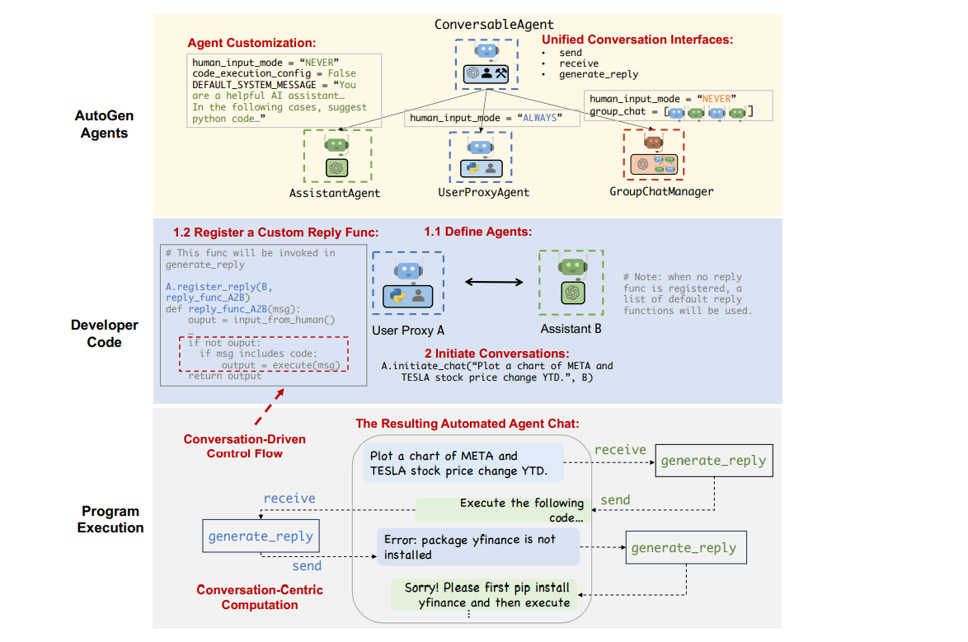
Example: Autogen, Wu et al.
Notes:
https://arxiv.org/abs/2308.08155

Slide 11
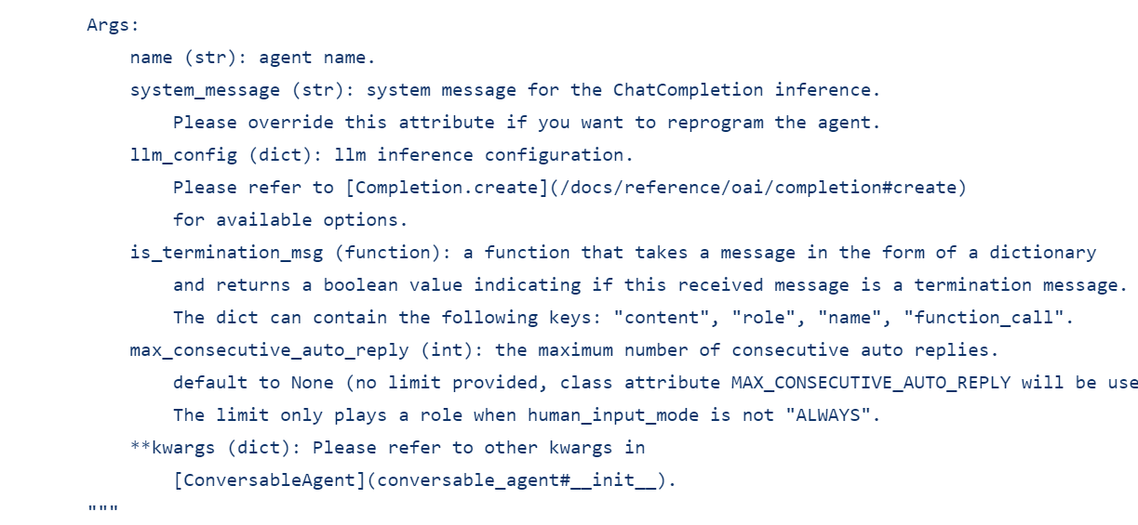
Autogen Agent Class
https://github.com/microsoft/autogen/blob/main/autogen/agentchat/assistant_agent.py

Slide 12
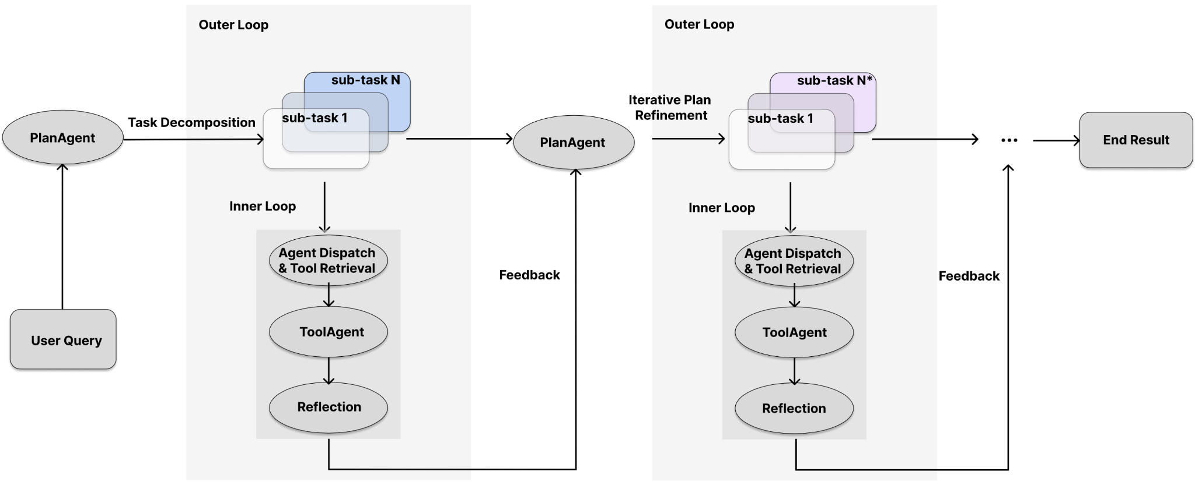
Example: XAgent
Image from: https://blog.x-agent.net/blog/xagent/
Notes:
https://blog.x-agent.net/blog/xagent/

Slide 13
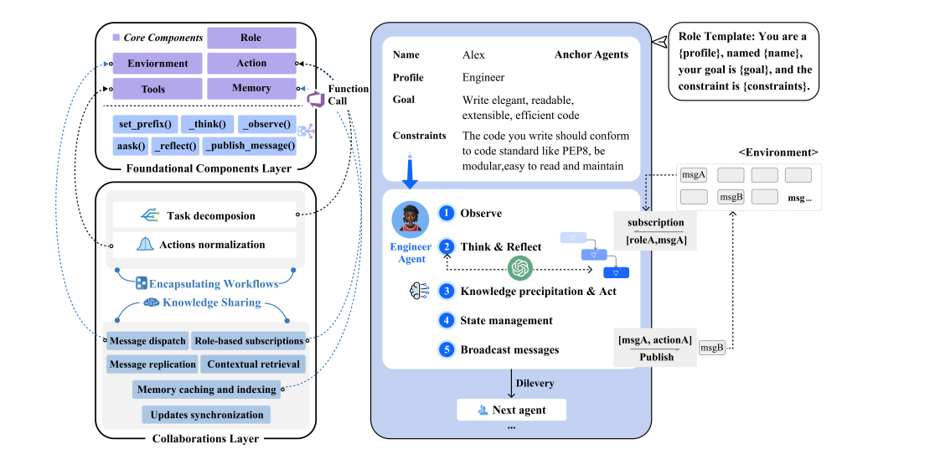
Example: MetaGPT
Image from: Hong et al, MetaGPT
Notes:
https://arxiv.org/abs/2308.00352

Slide 14
02
Task Decomposition

Slide 15
Task Decomposition
Currently extremely heavily reliant on prompting
ReAct framework - Thought, Action, Observation
Other techniques - Chain-of-Thought, Tree-of-Thoughts, Reflexion etc

Slide 16
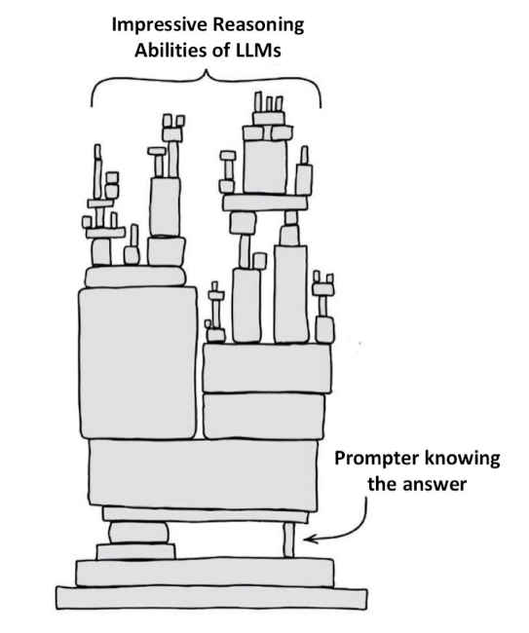
Task Decomposition
Image credit: Subbarao Kambhampati

Slide 17
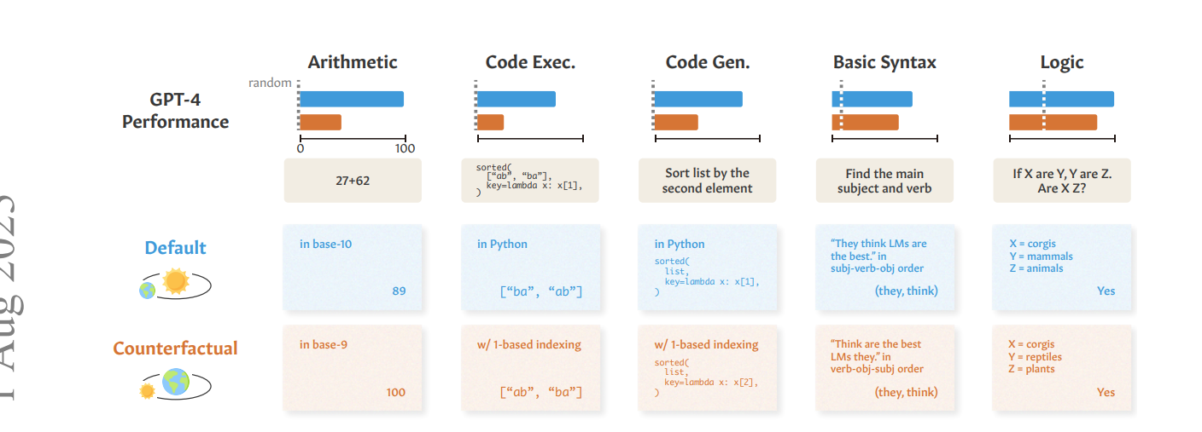
Wu et al: Reasoning or Reciting? Exploring the Capabilities and Limitations of Language Models
Through Counterfactual Tasks

Slide 18
03
Planning

Slide 19
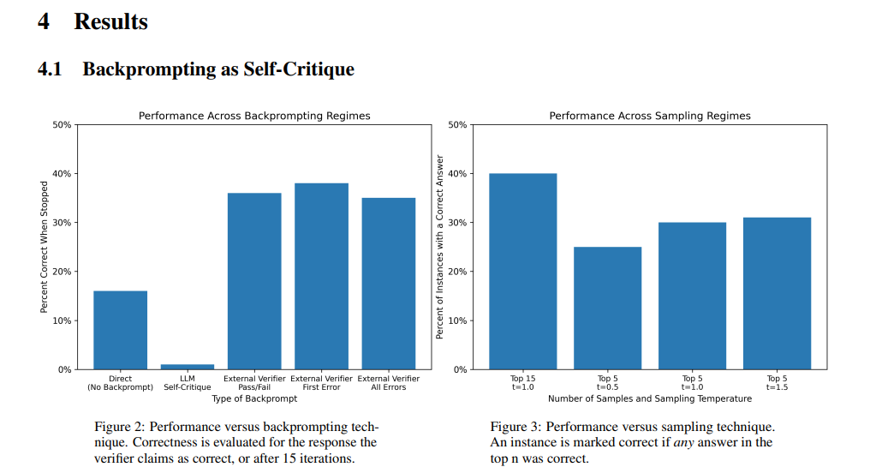
The Perils of Self-Critique
Stechly et al, GPT doesn’t know it is wrong
Notes:
https://arxiv.org/pdf/2310.12397.pdf

Slide 20
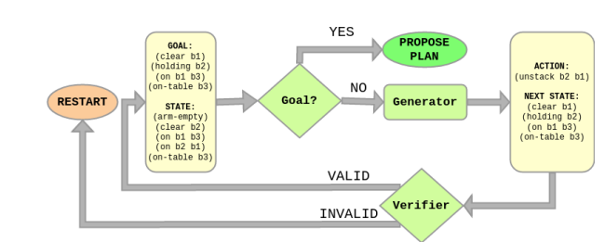
Improve Planning
Fine-tune a verification model and build it into the pipeline
Image Credit: Arora et al, Learning and leveraging verifiers to improve planning capabilities of pre-trained models

Slide 21
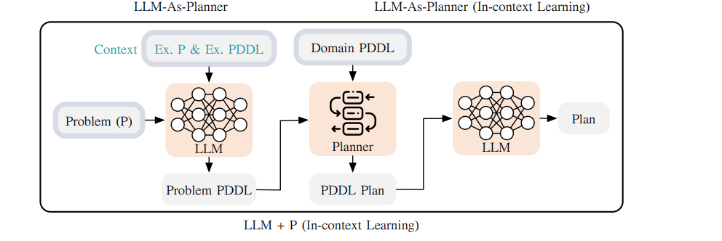
Improve Planning
Use symbolic planners
Image credit: Liu et al, LLM + P
Notes:
https://arxiv.org/pdf/2304.11477.pdf

Slide 22
04
Retrieval

Slide 23
Retrieval - Some Tips
Fine-tune your own embedding models
MPNET-based ones perform really well!
Embeddings == poor compressors

Slide 24
05
Tool Selection

Slide 25
Tool Selection Techniques
In-context/retrieval of tool descriptions
Finetuning on tool datasets
Tool tokens

Slide 26
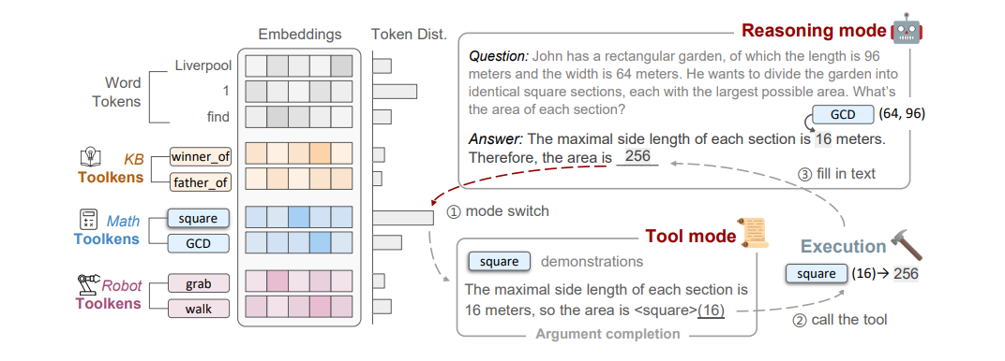
Tool Tokens - ToolkenGPT
Hao et al: ToolkenGPT
Notes:
https://arxiv.org/pdf/2305.11554.pdf

Slide 27
06
Tool Usage

Slide 28
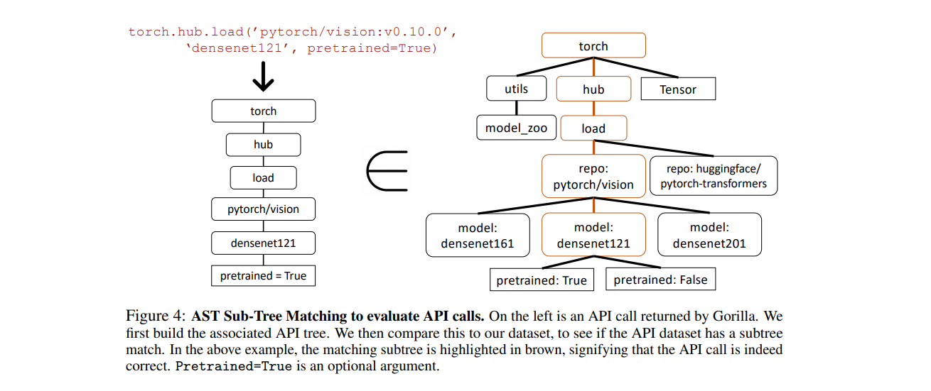
Tool Usage Verification
Patil et al: Gorilla: Large Language Model connected with Massive API’s

Slide 29
Thanks!
Do you have any questions?
piesauce@gmail.com
https://piesauce.substack.com
https://twitter.com/piesauce

